Slide 1
Computational Creativity
Game Generation

Slide 2
Content
1
Problem Description
4
Level Generation
2
VGDL & GVGAI
5
Rule Generation
3
Planning & Learning
6
Results

Slide 3

Problem Description

Slide 4

Can an AI solve a large set of ≠ games?
4

Slide 5
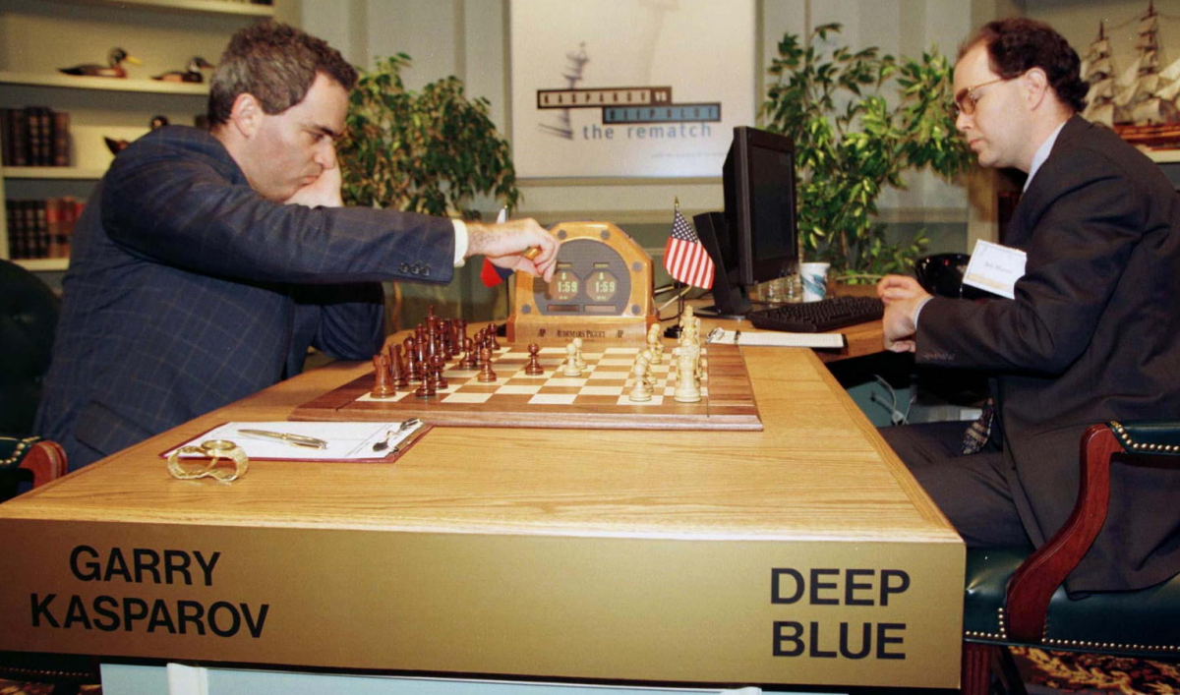
An AI can beat humans at chess

Slide 6

An AI can beat humans at Go

Slide 7
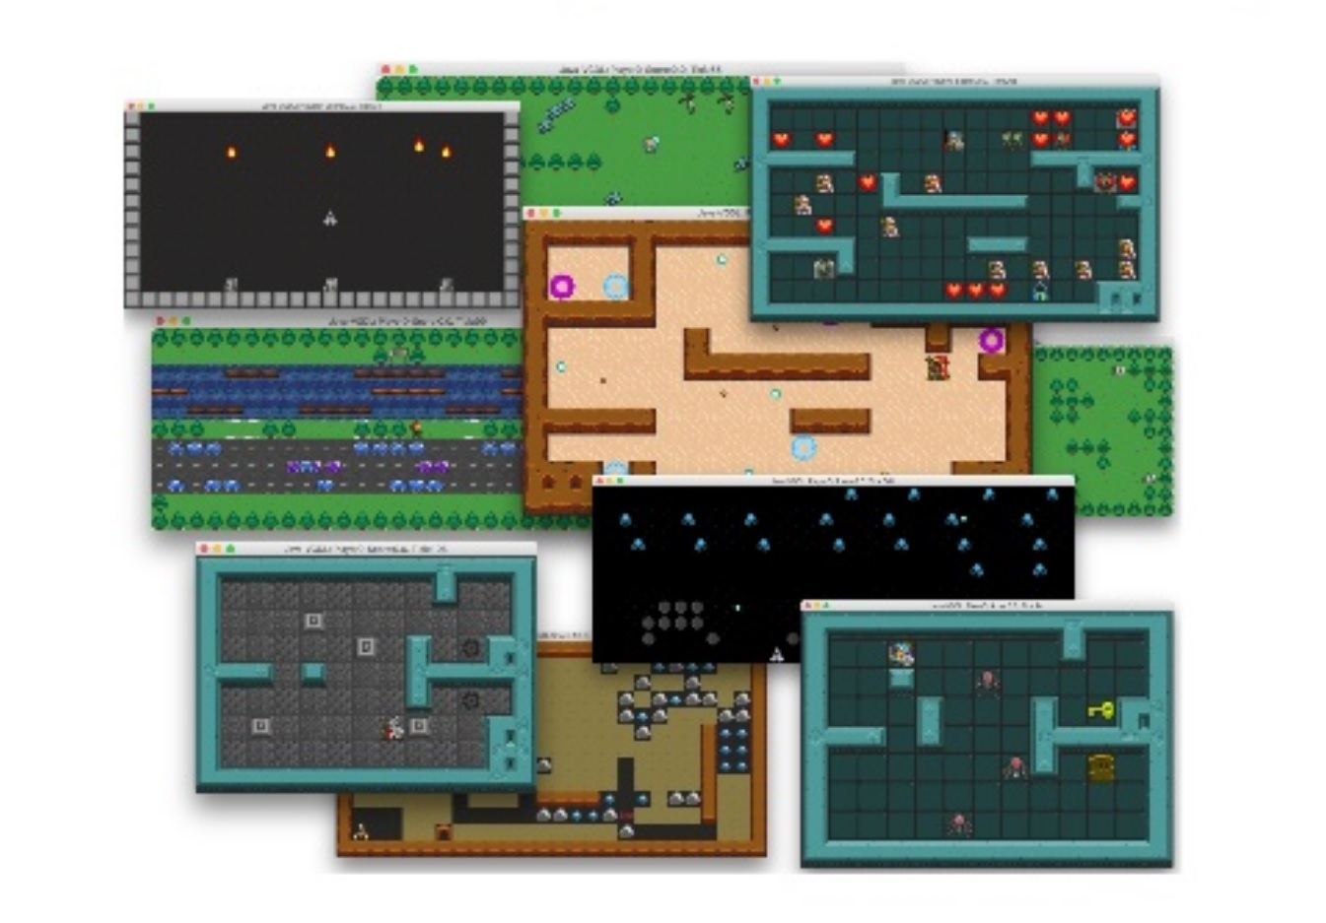
But what about an AI that can beat humans at any game?
Single-game AI’s overfit a solution to the game
Researches should develop agents without knowing which game they would be playing
General Video Game AI (GVGAI)

Slide 8

GVGAI
Framework and competition
Evaluates agents in an unseen set of games
“Improve the algorithm itself, not how it works in one particular game”

Slide 9

But how can we create games and describe them?
Video Game Description Language (VGDL)
Easily ceate games for both humans and algorithms
Easy to understand
Very compact

Slide 10
Can an AI generate content for ≠ games?
10

Slide 11

Procedural Content Generation (PCG)
Generate game content by an algorithm
Textures, levels, rules, etc.
Most techniques = constructive → based on game knowledge

Slide 12
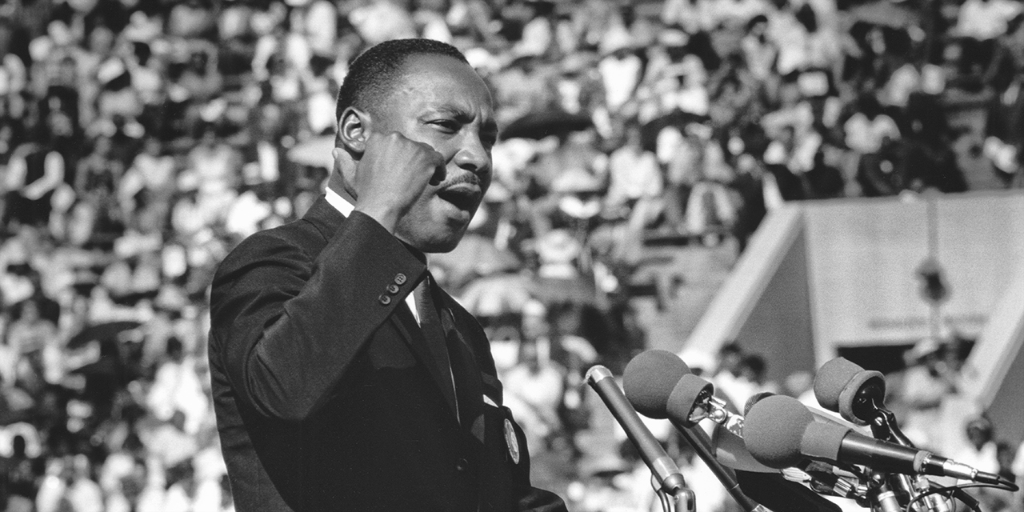
“I have a dream that one day…”
Algorithms generate content ≠ games
Algorithms can adapt between games
→ Level & Rule generation

Slide 13
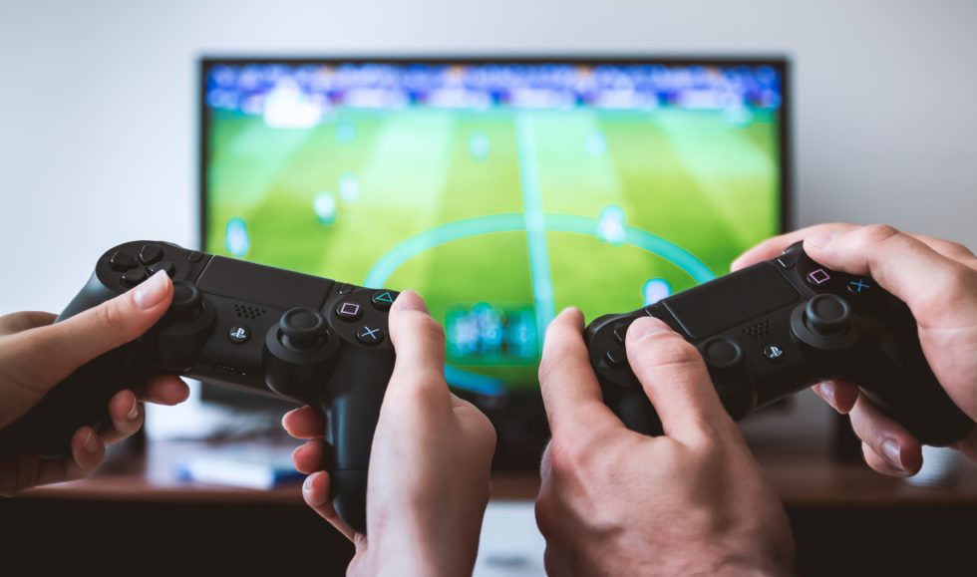
VGDL & GVGAI

Slide 14
How we use both frameworks?
VGDL
Express games in VGDL
Description of games and levels
GVGAI
GVGAI as benchmark
The engine that runs the descriptions

Slide 15
Advantages of separation
Possible to design/use a language concise and expressive enough to develop many games in
e.g. > 200 games described in VGDL
Not necessary to compile framework again and again for every newly created game
Easy to customize games and levels
Allows to create variants of games within minutes!
Avoid overfitting in learning agents by creating portfolio of games
Game and level generation

Slide 16
VGDL
To design 2D arcade-type games
Objects (sprites)
One object represents player (avatar)
Objects can interact with each other (e.g. ghost eats Pac-Man)

Slide 17
Separation of logic
Game description
Sprite set
Interaction set
Termination set
Level mapping
Level description

Slide 18
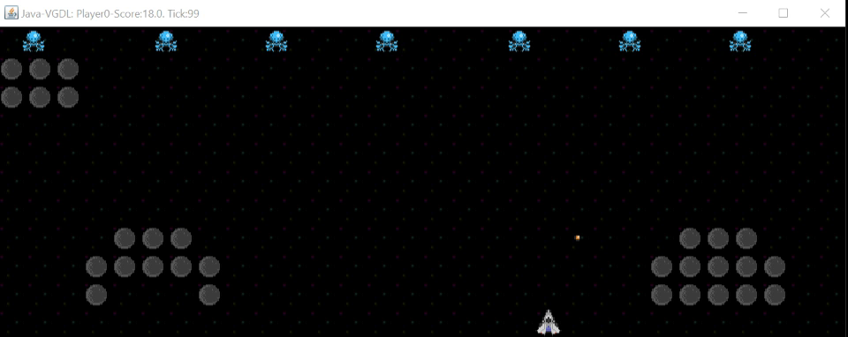
An Aliens example

Slide 19
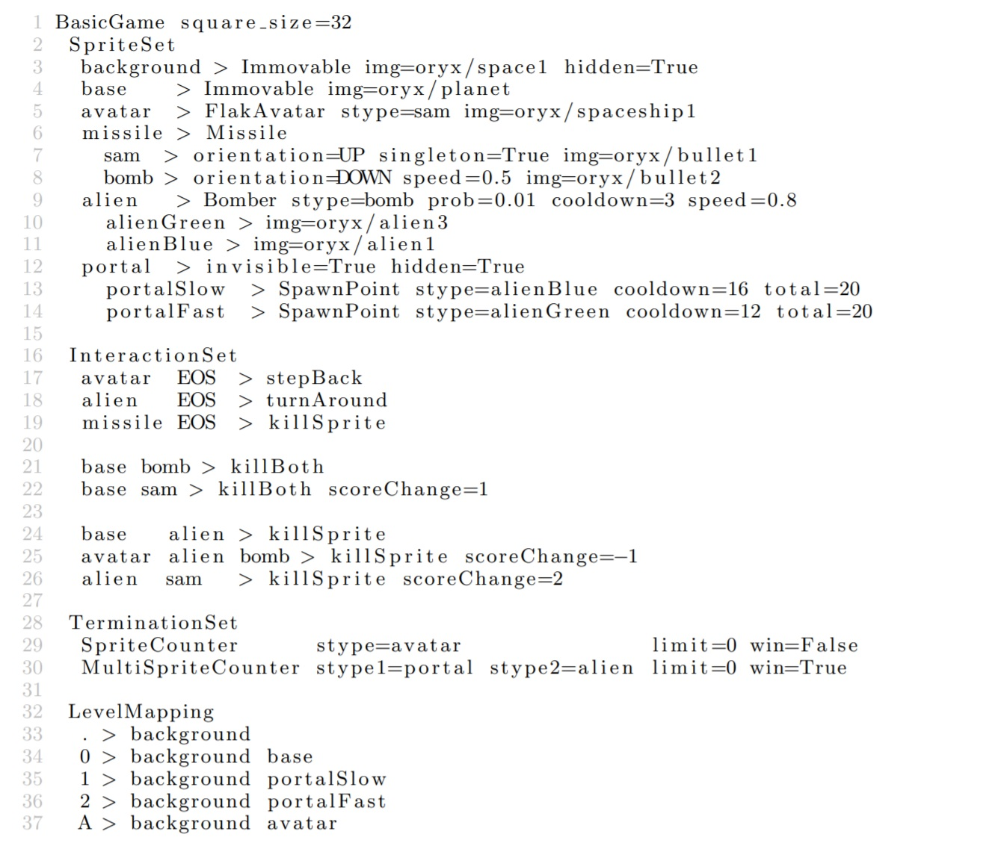
Aliens Definition (VGDL)

Slide 20
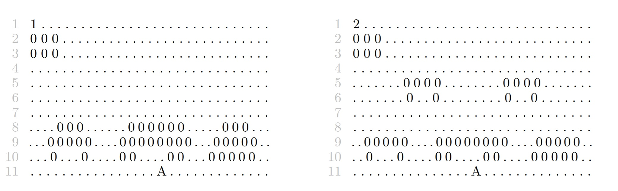
Two Aliens levels (VGDL)

Slide 21
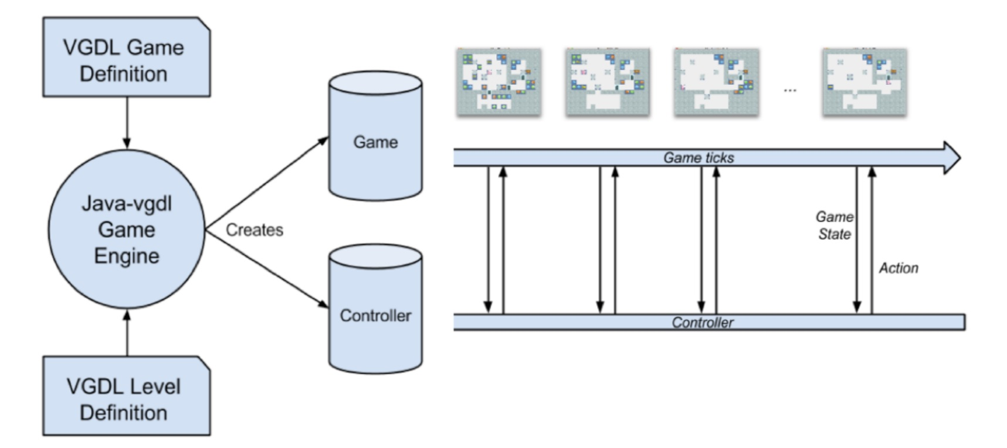
GVGAI framework

Slide 22
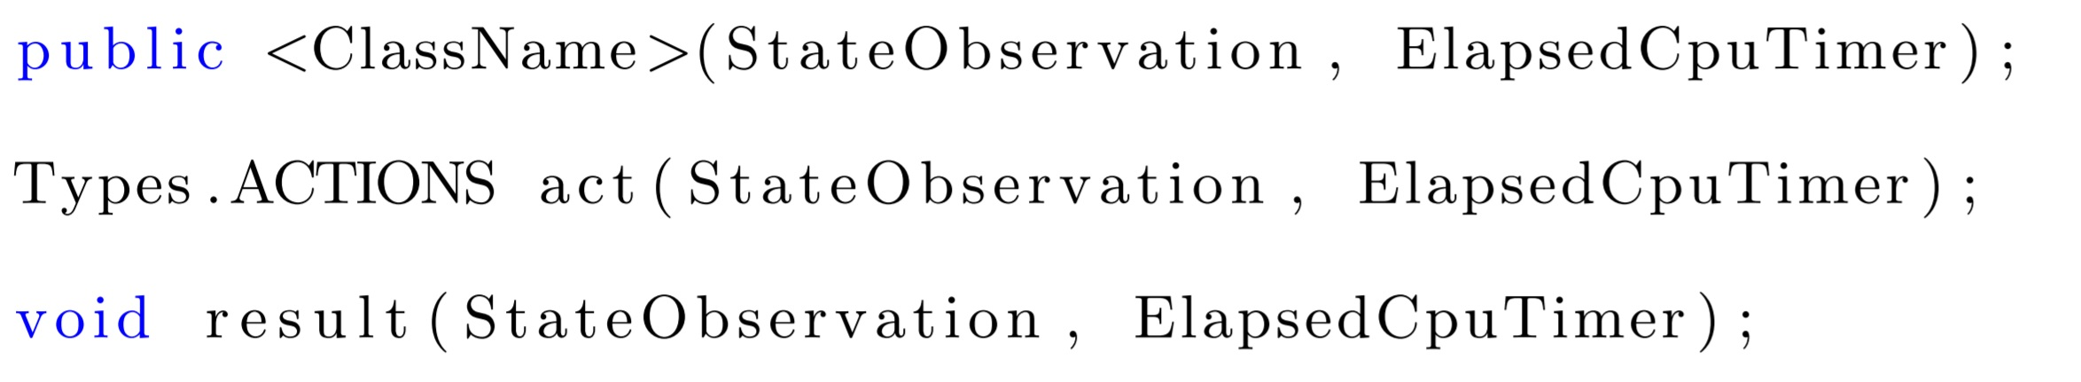
Controller interface

Slide 23
Controller interface
StateObservation
ElapsedCpuTimer
Score, health points
Victory state (win, loss, ongoing)
List of available actions for player
List of observations
History of avatar events
…
→ Provides Forward Model (FM)
Time left until action has to be returned

Slide 24
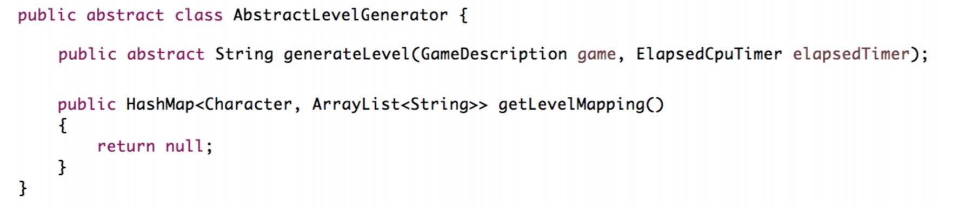
Level generation interface

Slide 25
Level generation interface
GameDescription
ElapsedCpuTimer
Provides access to game information
Remaining time for generator to finish → 5 hours to finish when running competition

Slide 26
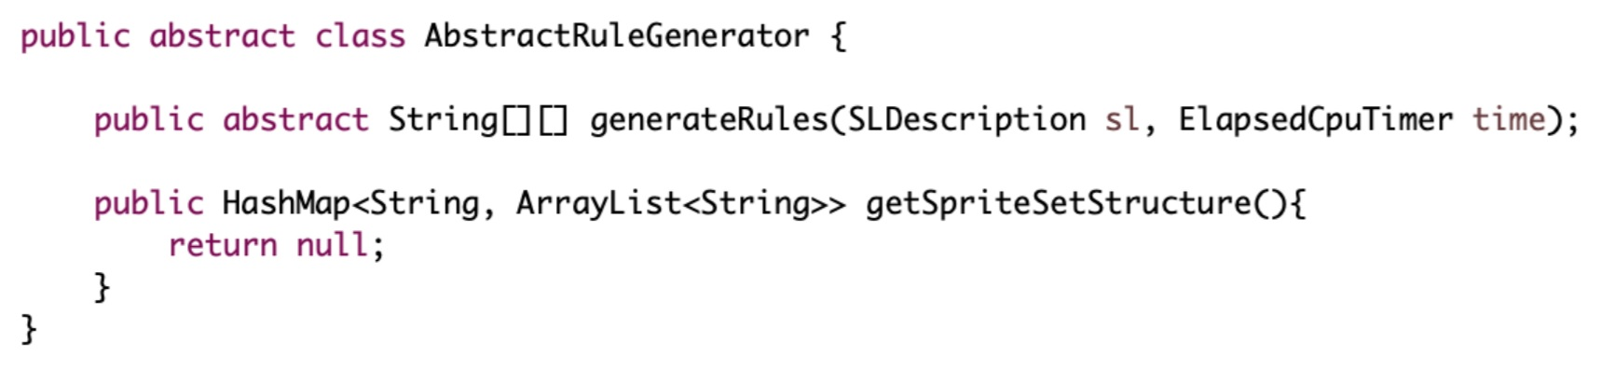
Rule generation interface

Slide 27
Rule generation interface
SLDescription
ElapsedCpuTimer
Provides list of game sprites to generator
And also a 2D-matrix = game level where each cell represents sprites present in that cell
Remaining time for generator to finish → 5 hours to finish when running competition

Slide 28

Planning & Learning

Slide 29
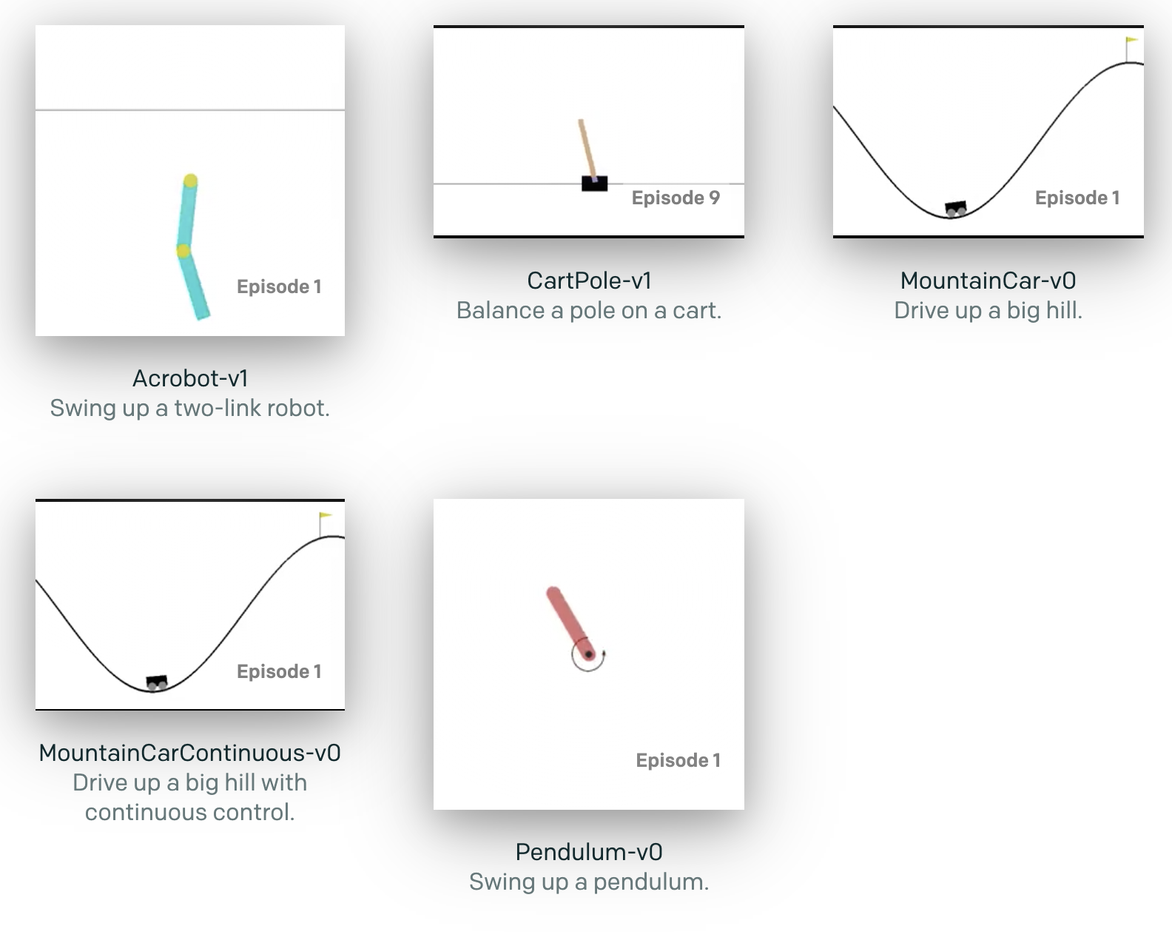
Learning Track
OpenAI Gym: Toolkit for Reinforcement Learning Algorithms
Environment for VGDL Games
Provide an Algorithm yourself (or baselines)
import gym
env = gym.make('CartPole-v0')
env.reset()
for _ in range(1000):
env.render()
env.step(env.action_space.sample()) # take a random action
env.close()
GVG-AI Gym: Gym env for GVGAI

Slide 30
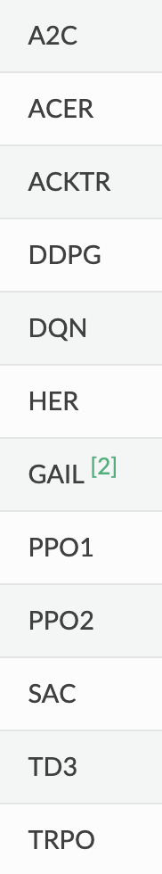
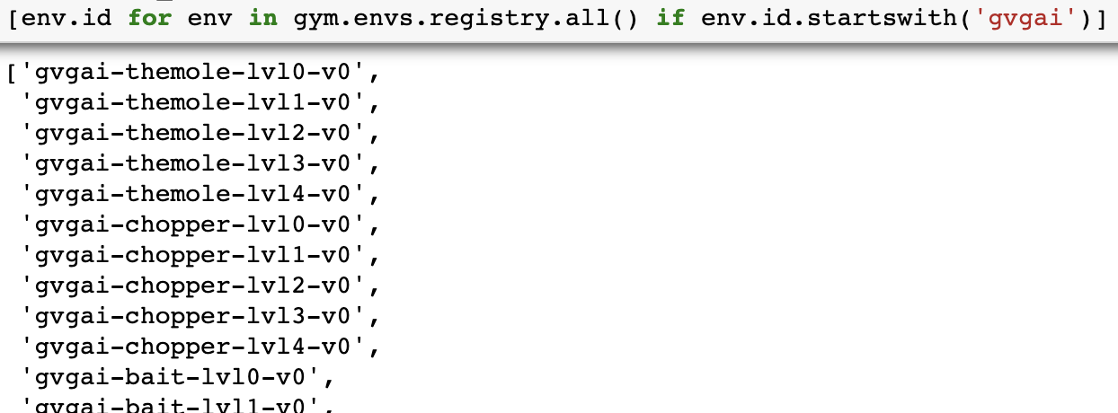
Learning Track
GVG-AI Gym: Gym env for GVGAI (https://github.com/rubenrtorrado/GVGAI_GYM)
OpenAI Baselines: set of ready RL algorithms
Stable Baselines: Improved Baselines algorithms

Slide 31
Learning Track
Different from Planning Track:
Planning track uses Forward Model (StateObservation) → simulate games
→ Q-Learning
Learning only has access to current game state:
SerializableStateObservation without Forward Model

Slide 32
Learning Track
Our goal:
Transform generated levels to OpenAI Environment (https://github.com/openai/gym/blob/master/docs/creating-environments.md)
Use several Stable Baselines Algorithms
Compare results

Slide 33
Learning Track
Training agents:
Callback function to monitor training
Periodically evaluate performance: save best model
Monitor.csv with reward and timesteps
Multi-processing
Evaluating agents:
Matplotlib for visualization

Slide 34
Learning Track
Currently: training agents lots of time!
Trial-and-error for parameters (learning rate, exploration rate,...)
Possibility to use pretrained agents..
Paper should cover results

Slide 35

Level Generation

Slide 36
Level Generation
Objective: build generator that generate levels for any game
Provided Interface:
Framework provides generator with game sprites, interaction set, termination conditions and level mapping
Also helper class GameAnalyzer: analyzes GameDescription object & provides additional information

Slide 37
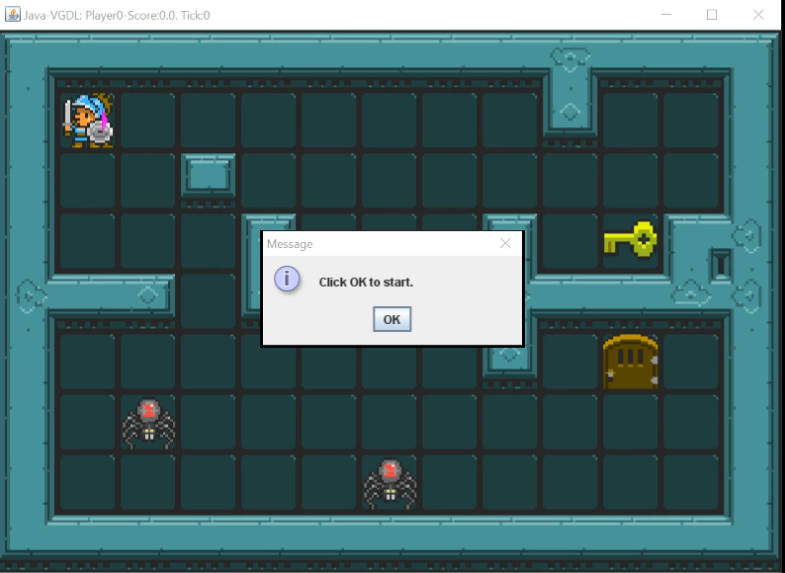
An example - Zelda

Slide 38
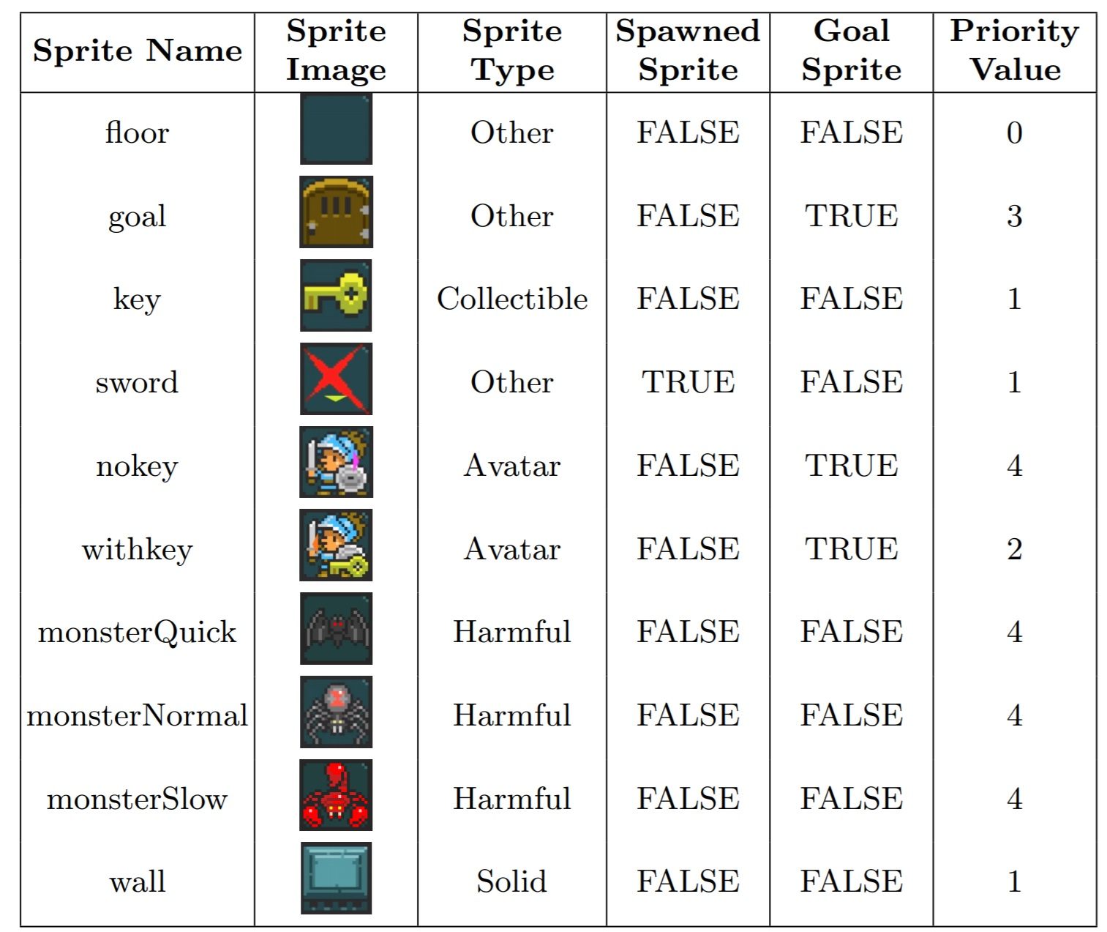
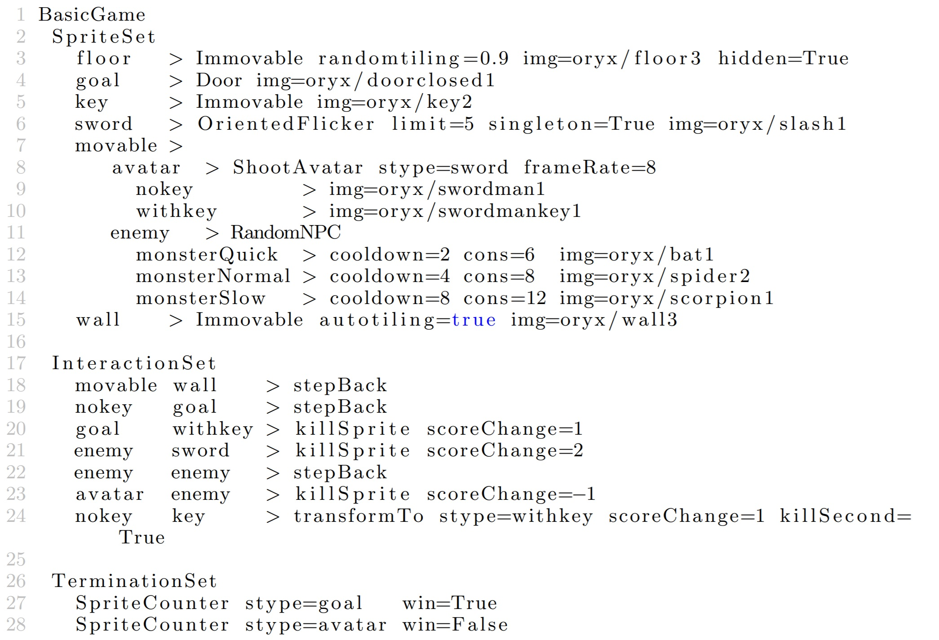
Zelda
GameAnalyzer Data
Definition

Slide 39
Level Generators
Random
Constructive
Search-based
Constraint-based

Slide 40
Random Generator
Create
Create a random sized level ~ # sprite types
Border
Add a solid border around level
Iterate
Iterate each tile and add random sprite with p = 0.1
Check
Make sure each sprite appears at least once & only one avatar

Slide 41
Constructive Generator
Pre-processing
Calculate cover percentage (% of tiles that will be covered with sprites)
Layout
Build level layout
Avatar
Add single avatar random position
Harmful
Add harmful sprites
Collectibles
Add collectible and other sprites
Post-processing
Fix goal sprites (> # sprites required for termination condition)

Slide 42
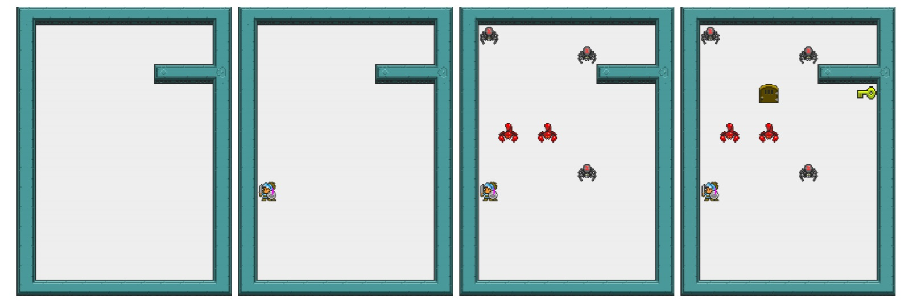
Constructive Generator applied to Zelda

Slide 43
Improved Constructive Generator
Map
Calculate map size
Layout
Build level layout like standard constructive generator
Avatar
Add avatar
Fill
Fill 10% of level with random sprites

Slide 44

Genetic Generator
Search-based
Feasible Infeasible 2-Population genetic algorithm (FI2Pop)
2 populations
Infeasible population: do not satisfy problem constraints
Feasible population: tries to improve fitness
During generation, if chromosome doesn’t satisfy constraints → transfer to infeasible population and vice versa
Initial population: populated using constructive generator
Chromosome = generated level (2D-array of tiles)

Slide 45
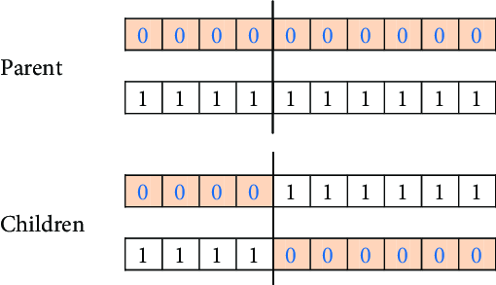
Genetic Generator
One-point crossover:
3 mutation operators: → Create: create random sprite at empty tile → Destroy: clear all sprites from a tile → Swap: swap 2 random tiles

Slide 46
Genetic Generator
Fitness calculation based on:
performance difference good vs. bad playing agent → good levels = high performance difference
Number of interactions → good levels have enough interactions to keep game interesting

Slide 47
Genetic Generator
Infeasible population constraints:
Avatar: only 1 each level
Sprites: at least 1 from each non spawned one
Goal: # goal sprites > # termination condition
Cover %: between 5% and 30% (not too empty/crowded)
Solution: not solvable in < 200 steps
Win: must be winnable by good performance agent
Death: avatar must not die in first 40 steps (makes sure avatar does not die in first seconds of game)

Slide 48
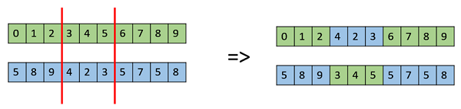
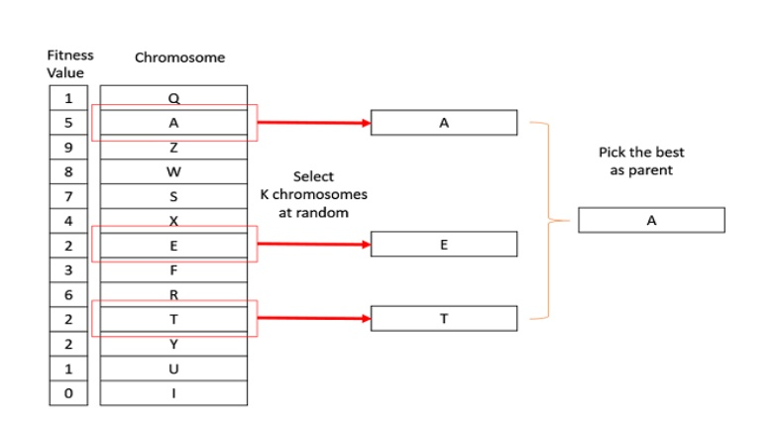
Improved genetic Generator
2-point crossover instead of 1-point crossover
Tournament selection instead of rank selection
Use Improved Constructive Generator for initialization

Slide 49

Rule Generation

Slide 50
Rule Generation
Create new playable games
Provided Interface:
Game level with all sprites provided (2D-matrix)
LevelAnalyzer object: analyzes provided level an allows user to get more information about sprites
Generator produces interaction set and termination conditions

Slide 51
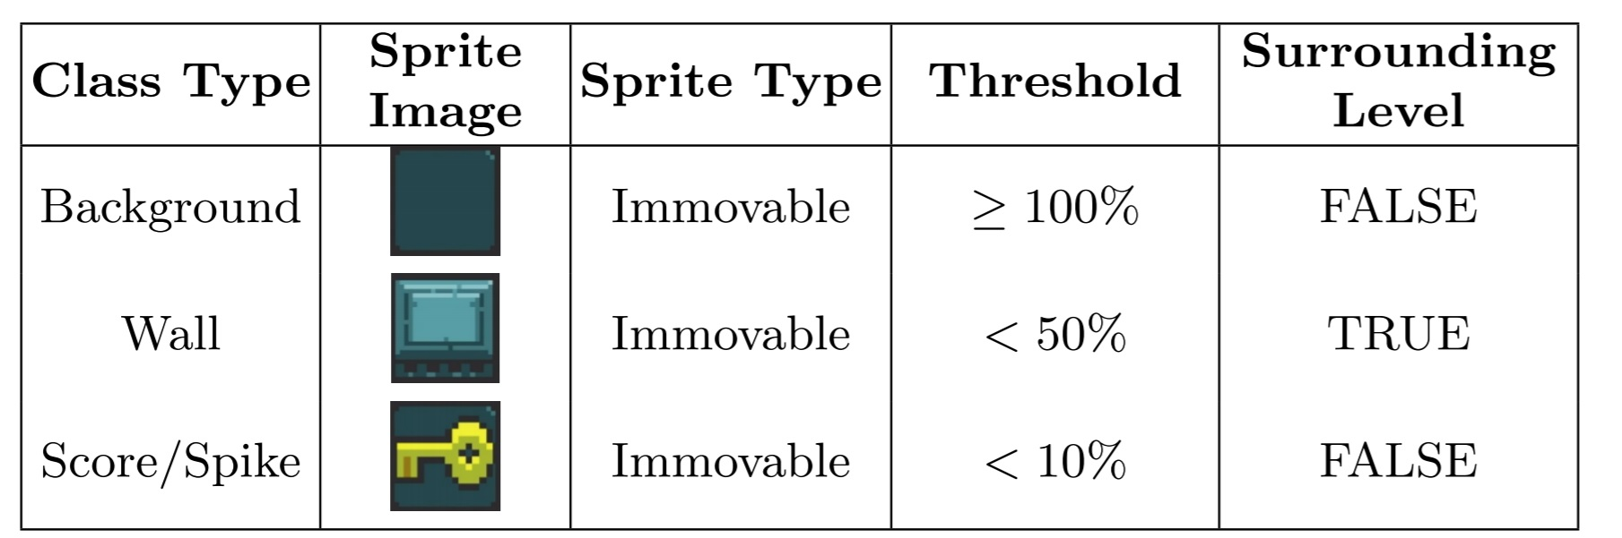
LevelAnalyzer Data Zelda

Slide 52
Rule Generators
Random
Constructive
Genetic

Slide 53
Random Generator
Choose
Choose random # of interactions
Generate
Generate # of interactions by: - Choose 2 random sprites - Choose random scoreChange value - Choose random interaction
Generate
Generate 2 terminal conditions (winning and losing)

Slide 55
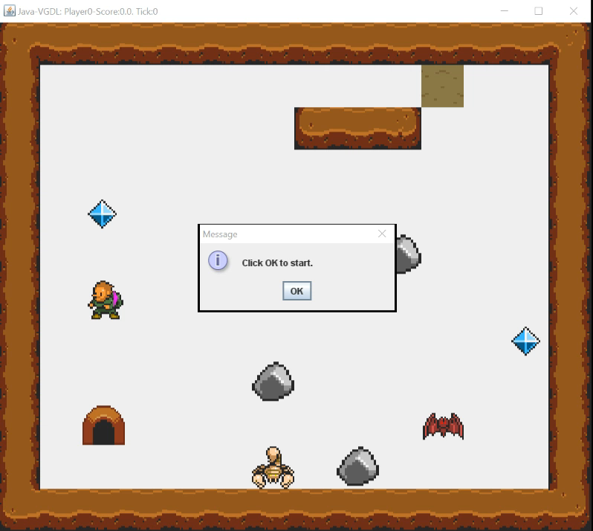

Slide 56
